Slide 1
Usability Testing concepts
Week 1

Slide 2

How to create the best product
Designing interactive products with good usability requires considering the following:
  What will the product do?
  Who will use it?
  Where will the product be used?
  How will they interact with the digital product

Slide 3
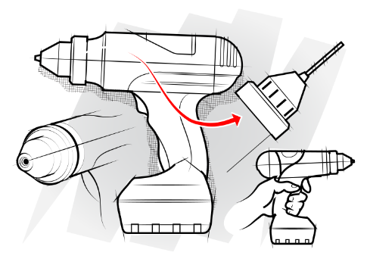
Example - issues to be considered when designing a new digital product
You are designing a new digital product to support communication, what are the issues to be considered?
?

Slide 4
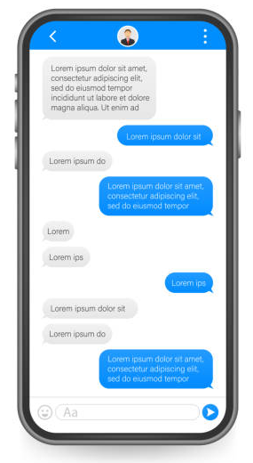

Example - issues to be considered when designing a new digital product
You are designing a new digital product to support communication, what are the issues to be considered?
?

Slide 5
Example - issues to be considered when designing a new digital product
You are designing a new digital product to support communication, what are the issues to be considered?
Issues to considered
  What
  Who
  Where
  How
    What type of communication synchronous or asynchronous?
    What is the target audience?
    In what context they will be using this system (personal, office)?
    What will be the format of communication (spoken or text)?
    If it is text, what will be the length of communication to be supported; will it support the inclusion of graphics, multimedia etc.
    What will be the number of participants
    What device/es (size/VR) and interactive interfaces (click/touch/speech)
    What type of interaction will be supported (speech, system: dialogues; menus; icons etc.)

Slide 6
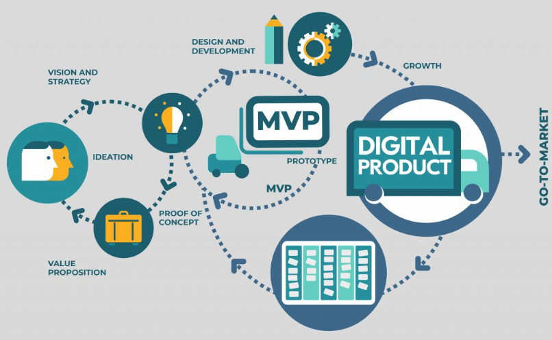

Digital product design process
Notes:
MVP - Minimum viable product (MVP) is a process for creating a production-ready product based on collaboration with users that undergoes continuous iterations and improvements until a “final” product is created. MVP design iterations are based on quantitative data and qualitative customer feedback.

Slide 7


Product evaluation
What does it mean to you that a product has good usability?
How do we know we have designed a good product?

Slide 8

Clarify the terminology
UX
UI
Usability
Usability testing
Notes:
“User Experience (UX) and User Interface (UI) are some of the most confused and misused terms in our field. A UI without UX is like a painter slapping paint onto a canvas without thought; while UX without UI is like the frame of a sculpture with no paper mache on it. A great product experience starts with UX followed by UI. Both are essential for the product’s success.”

Slide 9

UX vs UI design
UX
This is how users experience a product and what they do
UI
This is what designers create

Slide 10

What is user experience design?
UX
Is about the user experience
“User experience" encompasses all aspects of the end-user's interaction with the company, its services, and its products.
By Don Norman and Jakob Nielsen
Notes:
User experience design is a human-first way of designing products. Don Norman, a cognitive scientist and co-founder of the Nielsen Norman Group Design Consultancy, is credited with coining the term “user experience” in the late 1990s. Here’s how he describes it:
“User experience encompasses all aspects of the end-user’s interaction with the company, its services, and its products.”
– Don Norman, Cognitive Scientist & User Experience Architect
UX Design encompasses any and all interactions between a potential or active customer and a company.
As a scientific process it could be applied to anything; street lamps, cars, Ikea shelving, and so on.

Slide 11
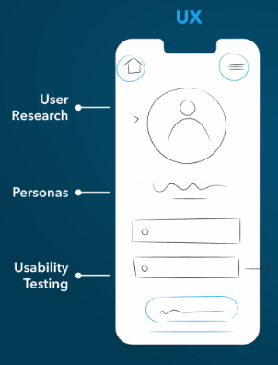
UX design is about
What features
What things will be in the product
How they work
How you feel while you are using them

Slide 12
What is user interface design?
UI
Is about the aesthetics experience
UI is made up of all of the pieces that allow a user to engage with a product or service at its most basic level.
Notes:
User experience design is a human-first way of designing products. Don Norman, a cognitive scientist and co-founder of the Nielsen Norman Group Design Consultancy, is credited with coining the term “user experience” in the late 1990s. Here’s how he describes it:
“User experience encompasses all aspects of the end-user’s interaction with the company, its services, and its products.”
– Don Norman, Cognitive Scientist & User Experience Architect
UX Design encompasses any and all interactions between a potential or active customer and a company.
As a scientific process it could be applied to anything; street lamps, cars, Ikea shelving, and so on.

Slide 13
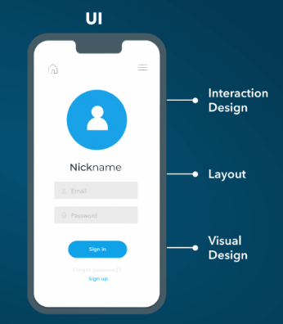
UI design is about
How things look as you are using them
How much space there is between things
How they are laid out
How much information is on each screen
Where to put things so it is easy for you to click on

Slide 14
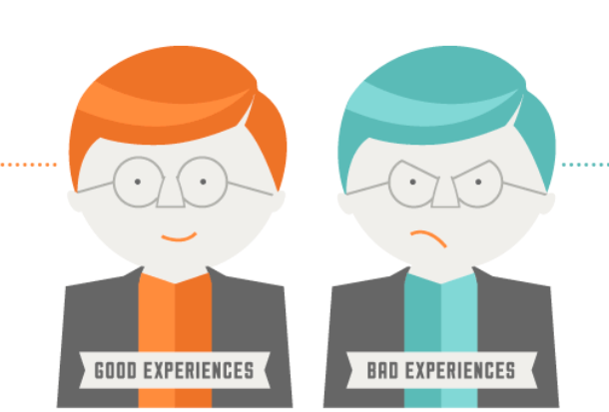
Why good UX and UI is important?
Why do we need to conduct a careful UX design process and a good UI?
Worst product ever. It was not intuitive, I could not understand what I had to do, the UI was in the way all the time, system feedback was poor. I encouraged errors all the time, I was clicking at the wrong buttons and I was selecting wrong options. The text was so difficult to read.
I am moving to another one.
Fantastic it offers everything I wanted, clear goals, clear UI, I knew what to do and I had a clear understanding of system status. It also looked good.

Slide 15
Utility
In the context of UX utility is the purpose of the product, what is the intended use
Definition of Utility = whether it provides the features you need.
Good UX and UI  usability
Definition of Usability = how easy and pleasant these features are to use.
Definition of Useful = utility + usability

Slide 16


Level of importance of usability
According to the Nielsen Norman Group —leaders in the UX field— usability is the second level in user experience. It comes after utility and before desirability and brand experience.
Daphne Economou & Jakob Nielsen at NNG UX Conference Amsterdam 2016
Utility
Usability
Desirability
Levels of user experience

Slide 17
Usability
Usability is a quality attribute that assesses how easy user interfaces are to use. The word "usability" also refers to methods for improving ease-of-use during the design process.
The best known definition of usability is the one from ISO, the International Organisation of Standardization (9241-11)
“ The extent to which a product can be used by specified users to achieve specified goals with effectiveness, efficiency, and satisfaction in a specified context of use.”
Usability ensures that a products is:
  easy to learn and use (intuitive)
  effective to use
  enjoyable for the user’s perspective (fun)

Slide 18
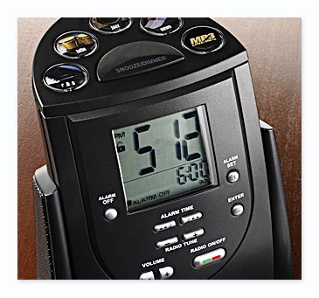
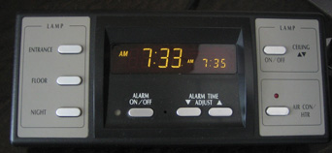
Example - hotel alarm clocks
“I travel a fair bit for work and one of the things that frustrate me are the hotel alarm clocks. They’re usually these big multifunctional radio/CD/alarm monsters with 100 buttons and switches. Getting up on time is the most important thing. The last thing I want is to be late on a business trip. And I don’t trust wake-up calls ever since a hotel messed it up. I always have to test the alarm-clock first and to be sure, I also set the alarm on my phone.”
“So it was very nice to see the following device next to my bed in Tokyo. Very simple. The buttons on the left controlled all the lighting in my room. Three buttons to set the alarm; on/off and time up and down. Easy. Another light button on the right plus an airco on/off. Thank you Odakyu Hotel Century Southern Tower.”
A study by Accenture found that 95% of the products returned work perfectly.
Hilton Hotels alarm clock
Odakyu Hotel Century Southern Tower.

Slide 19

Terminology
UX
UI
Usability
UX
UI
Usability
How users feel when interfacing with a system.
The system could be a desktop software, a web application or a game, is generally denoted by some form of human-computer interaction (HCI)
User Interface (UI), the visual elements (like pages, buttons, icons etc.) that users interact with a product or a service
Usability is the measure of the quality of a user's experience when interacting with a product or system - whether a web site, software application, mobile technology, or any user-operated device.
It is about metrics

Slide 20
When can we test usability?
We can test a product usability at various stages of product development, but it's most beneficial at the following key points:
  Ideation / Early Design Stage (Low-fidelity Prototypes or Usability Benchmarking)
  Design Stage (Mid-fidelity Prototypes)
  Development Stage (High-fidelity Prototypes or MVP)
  Pre-launch Stage (Beta Testing)
  Post-launch Stage (Ongoing Usability Testing)
Testing usability early and iteratively helps prevent costly redesigns and ensures the product meets user expectations.
Notes:
Usability testing can be conducted at various stages of product development, but it's most beneficial at the following key points:
Ideation / Early Design Stage (Low-fidelity Prototypes):
During this stage, you can test basic wireframes, sketches, or low-fidelity prototypes to gather initial feedback on how intuitive and user-friendly the design is. This helps in identifying major usability issues before significant development has occurred.
Design Stage (Mid-fidelity Prototypes):
Once you have more developed prototypes with actual layout, navigation flows, and basic interactions (but still not fully functional), usability testing can help refine the user interface (UI) and user experience (UX) based on user feedback.
Development Stage (High-fidelity Prototypes or MVP):
Testing a fully interactive prototype or Minimum Viable Product (MVP) gives users a near-real experience of the product, allowing you to evaluate usability in a more practical setting. Here, users can complete tasks, and you can measure task efficiency and satisfaction.
Pre-launch Stage (Beta Testing):
At this stage, the product is almost complete. Usability testing is crucial for discovering any remaining friction points, errors, or areas for improvement before the official release. Beta testers provide valuable insights into the final user experience.
Post-launch Stage (Ongoing Usability Testing):
Even after launch, continuous usability testing is important to ensure the product evolves with user needs, identifies overlooked issues, and improves the overall experience over time.
Testing usability early and iteratively helps prevent costly redesigns and ensures the product meets user expectations.

Slide 21
Usability testing
Usability testing is the practice of testing how easy a design is to use with a group of representative users.
  “It’s about catching customers in the act, and providing highly relevant and highly contextual information.”
  — Paul Maritz, CEO at Pivotal

Slide 22
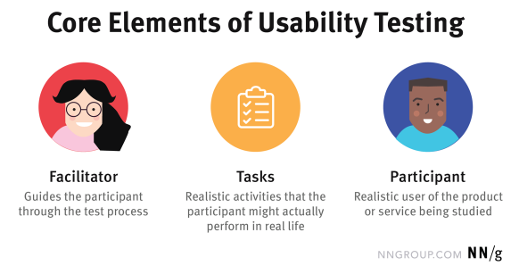
Elements of usability testing
“In a usability-testing session, a researcher (called a facilitator” or a “moderator”) asks a participant to perform tasks, usually using one or more specific user interfaces. While the participant completes each task, the researcher observes the participant’s behaviour and listens for feedback.”
  — NN/g
and records

Slide 23
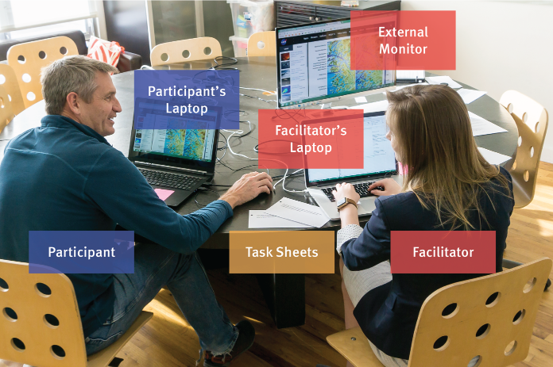
Elements of usability testing
NN/g https://www.nngroup.com/articles/usability-testing-101/

Slide 24
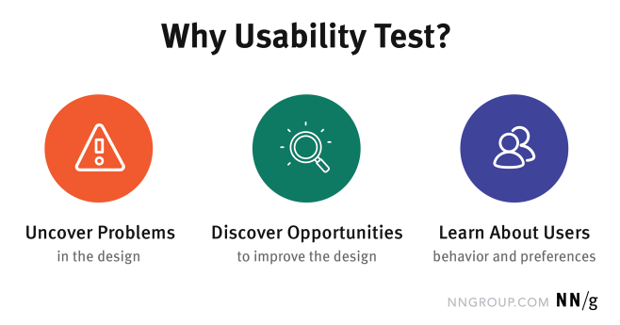
Why usability testing?

Slide 25
Goals of usability testing
Usability testing generally involves measuring how well test subjects respond in four areas:
  performance How much time, and how many steps, are required people to complete basic tasks? (For example, find something to buy, create a new account, and order the item.)
  accuracy How many mistakes did people make? (And were they fatal or recoverable with the right information?)
  recall How much does the person remember afterwards or after periods of non-use?
  emotional response How does the person feel about the tasks completed? Is the person confident, stressed? Would the user recommend this system to a friend?
The results of the first test can be treated as a baseline or control measurement; all subsequent tests can then be compared to the baseline to indicate improvement.

Slide 26


To clarify some confusion
Usability testing is a technique used to evaluate a product by testing it on users - observing users working with a product, performing tasks that are real and meaningful to them
It focuses on measuring a human-made product's capacity to meet its intended purpose
Rather than showing users a rough draft and asking, "Do you understand this?", usability testing involves watching people trying to use something for its intended purpose. For example, when testing instructions for assembling a toy, the test subjects should be given the instructions and a box of parts. Instruction phrasing, illustration quality, and the toy's design all affect the assembly process.
Usability testing gives direct input on how real users use the system in contrast with usability inspection methods where experts use different methods to evaluate a user interface without involving users
  The phrase “usability testing” is often used interchangeably with “user testing.”
Usability testing
User
testing
  Testing a product not a user

Slide 27
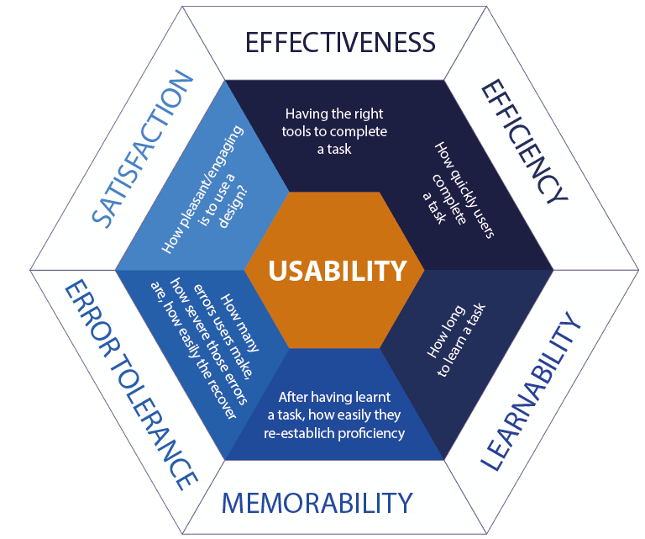
Usability is defined by 5 quality components
What do we measure?
Metric
A way of measuring and evaluating a particular phenomenon or item

Slide 28

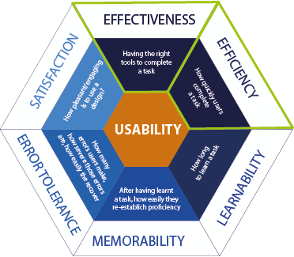

UX – Effectiveness [1]
Providing the right tools to complete a task / the extent to which something is successful in providing the desired result
It deals with:
  task completion
  How is it measured?
  Completed – Not/or partially completed

Slide 29
UX – Effectiveness [2]
Providing the right tools to complete a task / the extent to which something is successful in providing the desired result
It deals with:
  the way a system
  supports users in
  carrying out their tasks
  How is it measured?
  Noting down tools – routines
  Biometric tests
    Eye tracking: Shows how users’ visual attention, effective design directs users' attention to relevant areas.
    Low task success + high physiological stress (Galvanic Skin Response (GSR) / Heart Rate /HR) can confirm that users are struggling with the system.
    Increased cognitive load (pupil dilation/Electroencephalogram (EEG) during key steps may suggest areas where the design is not effective in guiding users.
    Frustration signals (facial expressions/voice analysis) during specific tasks can indicate that the system’s effectiveness is
Notes:
Here's how biometric data can be integrated into usability studies focusing on effectiveness:
1. Eye Tracking
How it works: Eye-tracking devices measure where and how long a user looks at different elements on a screen, how their gaze moves, and whether they focus on the right places to complete a task.
What it reveals:
Gaze patterns: Effective designs direct users' attention to relevant areas. Ineffective systems may cause users to fixate on irrelevant areas or engage in unnecessary searching.
Fixations and saccades: Long fixations or erratic eye movements (saccades) may indicate confusion or difficulty, signaling reduced effectiveness.
Heatmaps: Heatmaps can show areas of user interest or where they struggled, providing insights into how effectively a user can find necessary elements to complete a task.
Example: If users struggle to find a button to complete a task, eye-tracking data will show prolonged fixations or search patterns, indicating a problem with effectiveness in task completion.
2. Galvanic Skin Response (GSR) / Electrodermal Activity (EDA)
How it works: GSR sensors measure changes in the electrical properties of the skin, which fluctuate with stress or emotional arousal.
What it reveals:
Stress or frustration: High GSR readings during task completion can suggest that users are experiencing stress, frustration, or cognitive overload, potentially because the task is difficult or unclear.
Engagement: Sudden spikes in GSR may reflect moments of difficulty or confusion, correlating with reduced task effectiveness.
Example: If a user exhibits heightened stress levels when trying to complete a form, it may indicate that the system's design or process is not effective in guiding the user through the task.
3. Heart Rate (HR) and Heart Rate Variability (HRV)
How it works: Heart rate monitors track the speed and variability of a user's heartbeat. HRV is particularly useful for gauging the body's stress response.
What it reveals:
Stress and workload: Increased heart rate or reduced HRV can indicate cognitive strain, stress, or frustration, which are often linked to reduced effectiveness.
Task difficulty: Sudden changes in heart rate when performing a specific task can highlight points of difficulty, signaling where the product's usability is compromised.
Example: If heart rate spikes during a complex navigation task, this may suggest the system isn't effective in helping users complete tasks smoothly.
4. Facial Expression Analysis
How it works: Using facial recognition software, researchers can detect micro-expressions that reveal emotional states like frustration, confusion, or satisfaction.
What it reveals:
Emotional responses: Positive or negative facial expressions during task completion can indicate how effectively the system supports the user. Negative expressions (e.g., furrowed brows, frowns) may indicate that the user is struggling with the task.
Correlating emotions with effectiveness: Consistently negative facial expressions during task failure or complexity can indicate areas where effectiveness is lacking.
Example: If users show signs of frustration when searching for information on a website, this suggests that the website's design is not effective in supporting users’ goals.
5. Pupil Dilation (Cognitive Load)
How it works: Pupil dilation is often measured via eye-tracking or specialized biometric equipment. Pupil dilation increases when cognitive load or mental effort increases.
What it reveals:
Cognitive workload: Larger pupil dilation suggests higher mental effort or cognitive overload, which may indicate that the user is struggling to complete the task effectively.
Effectiveness of design: If a task requires more mental effort than expected, it can signal that the design or process is not intuitive or effective.
Example: If users’ pupils dilate significantly while trying to fill out a multi-step form, it may indicate that the form is overly complex or confusing, reducing task effectiveness.
6. EEG (Electroencephalogram) – Brainwave Activity
How it works: EEG sensors measure electrical activity in the brain, providing insights into cognitive states such as attention, workload, and stress.
What it reveals:
Mental workload: High levels of certain brainwave patterns (e.g., theta or beta waves) may indicate increased cognitive load, which could point to difficulties in completing a task.
Focus and engagement: EEG data can reveal when users are focused or distracted, offering insights into whether the system effectively holds the user's attention during task completion.
Example: If EEG data shows heightened cognitive load when users interact with a poorly structured interface, this suggests that the design is not effective in supporting task completion.
7. Voice Stress Analysis
How it works: Voice stress analysis software can analyze vocal tone, pitch, and variability to detect emotional states like stress, confusion, or frustration.
What it reveals:
Stress and difficulty: Changes in voice pitch or tone can indicate when a user is stressed or frustrated while attempting to complete a task.
Task complexity: If users' voice stress increases at certain points during a task, it suggests that those steps are too difficult or unclear, reducing the effectiveness of the system.
Example: If voice stress increases while navigating through a checkout process, it may reveal an ineffective flow, possibly due to poor design or confusing steps.
Summary of Biometrics and Effectiveness:
Effectiveness in usability can be enhanced by studying biometric data alongside traditional metrics like task success rate. For example:
Low task success + high physiological stress (GSR/HR) can confirm that users are struggling with the system.
Increased cognitive load (pupil dilation/EEG) during key steps may suggest areas where the design is not effective in guiding users.
Frustration signals (facial expressions/voice analysis) during specific tasks can indicate that the system’s effectiveness is compromised.
By integrating biometric data, usability researchers can go beyond observing task outcomes (success/failure) and gain deeper insights into why users may struggle or succeed. This data provides an additional layer of understanding to refine product designs and improve task effectiveness.

Slide 30
UX – Effectiveness [3]
Providing the right tools to complete a task / the extent to which something is successful in providing the desired result
It deals with:
  overall relative
  effectiveness
  How is it measured?
  Qualitative – opinions

Slide 31

UX – Efficiency
Users are provided with the tools to complete actions accurately and can perform tasks quickly through the easiest process.
It deals with:
  How is it measured?
  Time
  Noting down tools – routines
  Qualitative - opinions
  task completion time
  the way a system supports users in carrying out their tasks
  overall relative efficiency

Slide 32

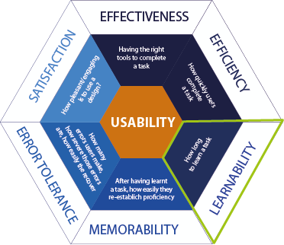

UX - Ease of learning/learnability [1]
How easy is it for users to accomplish basic tasks the first time they encounter the design?
It deals with:
  How is it measured?
  Time – how long it takes:
    to get started using a system to perform core tasks, and
    to learn the range of operations to perform a wider set of tasks
  how easy a system is to learn to use
  a key concern is determining how much times users are prepared to spend learning a system, there is no point in developing a range of functionality if the majority of the users are unable or not prepared to spend time learning how to use it

Slide 33
UX - Ease of learning/learnability [2]
How easy is it for users to accomplish basic tasks the first time they encounter the design?
It deals with:
  How is it measured?
  Cognitive load – biometric tests
  how easy a system is to learn to use
    Eye tracking: Shows how users’ visual attention becomes more efficient over time.
    Galvanic Skin Response (GSR) / Electrodermal Activity (EDA): Indicates reduced stress as users become more comfortable with tasks.
    Heart Rate (HR) and Heart Rate Variability (HRV): Reflects reduced cognitive load and stress as tasks become easier to perform.
    Pupil dilation: Demonstrates decreasing cognitive effort as users learn tasks.
    EEG (Electroencephalogram) – Brainwave Activity: Tracks improvements in focus and reductions in mental workload.
    Facial expressions: Highlights emotional changes (e.g., reduced frustration) as learnability improves.
    Voice stress: Shows decreasing vocal stress as users gain confidence.
Notes:
Here’s how various biometric methods can help measure and study learnability:
1. Eye Tracking
How it works: Eye-tracking devices record users’ gaze patterns, fixations, and saccades (quick eye movements) as they interact with a system. By studying changes in eye movements over time, researchers can evaluate how users learn to navigate interfaces.
What it reveals about learnability:
Gaze patterns improvement: As users become more familiar with a system, their gaze patterns should become more efficient. Initial sessions may show long fixations or erratic saccades as users search for information, but as learnability improves, these should decrease.
Reduced searching time: If users quickly locate key elements in later sessions, it suggests that they have learned where things are and how to navigate the interface effectively.
Example: In early sessions, a user may spend considerable time searching for navigation buttons (indicated by long fixations and saccades), but in later sessions, the user’s eye movements will likely be more focused and direct as they learn the system.
2. Galvanic Skin Response (GSR) / Electrodermal Activity (EDA)
How it works: GSR measures changes in skin conductance that correlate with emotional arousal or stress. High stress levels during tasks can indicate that a user finds the system difficult to learn or use.
What it reveals about learnability:
Decreased stress levels over time: Initially, GSR readings may be high as users experience cognitive overload while learning new tasks. However, as they become more comfortable and familiar with the system, their GSR levels should decrease, indicating that the system is learnable.
Learning curve tracking: By comparing GSR data across multiple testing sessions, researchers can observe how stress levels change as users repeat tasks and gain proficiency.
Example: A user might show high GSR spikes while performing tasks in early sessions, indicating stress or confusion. As the user repeats the task and learns the process, GSR levels should decline, indicating reduced stress and improved learnability.
3. Heart Rate (HR) and Heart Rate Variability (HRV)
How it works: HR monitors measure heart rate, while HRV refers to the variation in time between consecutive heartbeats. Changes in heart rate or HRV can indicate cognitive load or stress levels.
What it reveals about learnability:
Reduced cognitive load: Initially, learning a new interface may cause users to experience increased heart rates, suggesting cognitive strain. Over time, as users learn the system, their heart rate should stabilize, indicating that tasks have become easier.
Decreased task stress: Lower heart rate and higher HRV in later sessions can indicate that users are more relaxed and confident with the interface, reflecting improved learnability.
Example: In the first few sessions, a user’s heart rate may increase significantly during complex or unfamiliar tasks. As the user repeats the task and learns the interface, heart rate and HRV should normalize, indicating reduced stress and greater familiarity.
4. Pupil Dilation (Cognitive Load)
How it works: Pupil dilation is measured to assess cognitive load. Pupil size increases when users are mentally engaged or facing a high cognitive load.
What it reveals about learnability:
Decreasing cognitive load: In early stages of learning, users’ pupils may dilate more, indicating higher cognitive effort to understand the system. As users learn and tasks become easier, pupil dilation should decrease, indicating reduced cognitive effort.
Improvement over time: By tracking pupil dilation across multiple sessions, researchers can observe how much cognitive load is required as users learn the interface, and whether the system becomes more intuitive.
Example: If a user shows large pupil dilation during early tasks, it suggests high cognitive load while learning. In later sessions, less dilation would indicate that the user has learned the system, leading to reduced mental effort.
5. EEG (Electroencephalogram) – Brainwave Activity
How it works: EEG monitors electrical brain activity, particularly useful for assessing mental states such as concentration, attention, and workload. It measures different brainwave frequencies (e.g., alpha, beta, theta) that correspond to mental processes.
What it reveals about learnability:
Decreased mental workload: EEG readings can show when users experience high cognitive load (e.g., more beta wave activity) during initial learning phases. As users become more familiar with the system, the cognitive workload should decrease, reflected by changes in brainwave patterns.
Increased focus: EEG can also track whether users’ attention improves over time. As learnability increases, users tend to focus more effectively on key tasks without distraction.
Example: Early EEG data might show increased beta wave activity as users learn a new task, indicating high cognitive effort. As the task becomes more familiar in subsequent sessions, EEG patterns will show reduced cognitive load, indicating improved learnability.
6. Facial Expression Analysis
How it works: Facial recognition technology can detect micro-expressions that reveal emotional states such as confusion, frustration, or satisfaction during the learning process.
What it reveals about learnability:
Fewer negative expressions over time: Facial expressions of frustration or confusion (e.g., frowns, furrowed brows) during early learning stages may decrease as users become more familiar with the system, indicating that the system is learnable.
Positive feedback loop: Increased signs of positive expressions (e.g., smiles or neutral expressions) in later sessions may indicate that the user is becoming more comfortable and confident with the system.
Example: In initial testing sessions, a user may show signs of frustration or confusion while learning how to perform a task. As learnability improves, these negative expressions may diminish, indicating a smoother and more intuitive experience.
7. Galvanic Voice Stress Analysis
How it works: Voice stress analysis can detect changes in vocal pitch, tone, and variability that may indicate stress or confusion during the learning process.
What it reveals about learnability:
Reduced vocal stress over time: As users learn the system, their speech should become more relaxed and confident, with less evidence of vocal stress or strain. High vocal stress at the beginning may decrease as users grow familiar with the tasks.
Increased confidence: In later sessions, a calmer and more steady voice suggests that users have learned how to navigate and use the system effectively.
Example: During initial interactions with a complex task, a user may exhibit a higher-pitched, strained voice. Over time, as the task becomes more familiar, their voice may become more even and relaxed, indicating that the user has learned the task.
How to Apply Biometric Data for Learnability:
Conduct longitudinal usability tests: Monitor users over multiple sessions to observe how their physiological responses change as they interact with the system.
Combine biometrics with traditional metrics: Use task completion rates, error counts, and subjective measures (e.g., questionnaires) alongside biometric data to get a fuller picture of how well users are learning the system.
Track changes in biometric indicators: Compare biometric data across early and later stages of learning to identify improvements in stress, cognitive load, and user engagement.
Summary of Biometric Data for Studying Learnability:
Eye tracking: Shows how users’ visual attention becomes more efficient over time.
GSR/EDA: Indicates reduced stress as users become more comfortable with tasks.
Heart rate/HRV: Reflects reduced cognitive load and stress as tasks become easier to perform.
Pupil dilation: Demonstrates decreasing cognitive effort as users learn tasks.
EEG: Tracks improvements in focus and reductions in mental workload.
Facial expressions: Highlights emotional changes (e.g., reduced frustration) as learnability improves.
Voice stress: Shows decreasing vocal stress as users gain confidence.
Together, these biometric indicators provide a rich and objective way to assess learnability, complementing traditional usability metrics to offer a more detailed understanding of how users adapt and improve over time.

Slide 34
UX - Ease of learning/learnability [3]
How easy is it for users to accomplish basic tasks the first time they encounter the design?
It deals with:
  How is it measured?
  Processes – what tools do users really use
  how easy a system is to learn to use

Slide 35
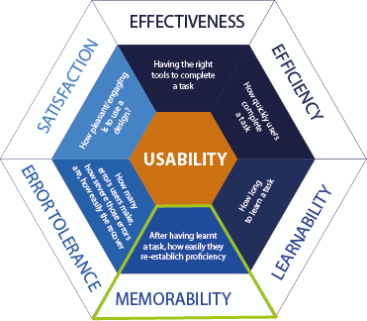

UX – Memorability [1]
How easy a system is to remember how to use, once learned
When users return to the design after a period of not using it, how easily can they re-establish proficiency?
It deals with:
  How is it measured?
  The can – they cannot
  Time
  Number of errors
  They can recover – they cannot
  What tools do they access, and at what point of interaction
  Can they remember how to conduct a task they used to do in the past
  how long it takes them to do so, can they remember a routine
  do they make errors
  can they recover from errors
  do they remember how to access support?

Slide 36
UX - Ease of learning/memorability [2]
  key issue for systems that are used infrequently – the users should be able to remember or be reminded how to use it
  users shouldn’t keep relearning how to carry out tasks – this happens when the operations required are illogical, obscure or poorly sequenced
  users can be helped to remember how to do tasks by being helped to remember a sequence of operations at different stages of a task, or with the aid of icons, command names, menu options
  structuring options and icons in relevant categories can help the user remember where to look to find relevant tools
  Q: What kind of interface support have been provided to help users remember how to carry out tasks, especially for systems and operations that are used infrequently?

Slide 37
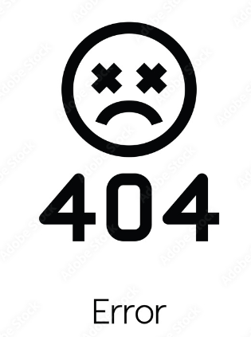
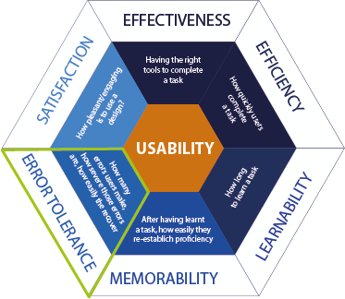

UX - Error tolerance [1]
It supports a range of user actions and only shows an error in genuine erroneous situations. You achieve this by finding out the number, type, and severity of common errors users make, as well as how easily users can recover from those errors.
It deals with:
  How is it measured?
  Number of errors
  Scale of severity
  Time
  How many errors do users make?
  How severe those errors are?
  How easily can they recover from the errors?

Slide 38

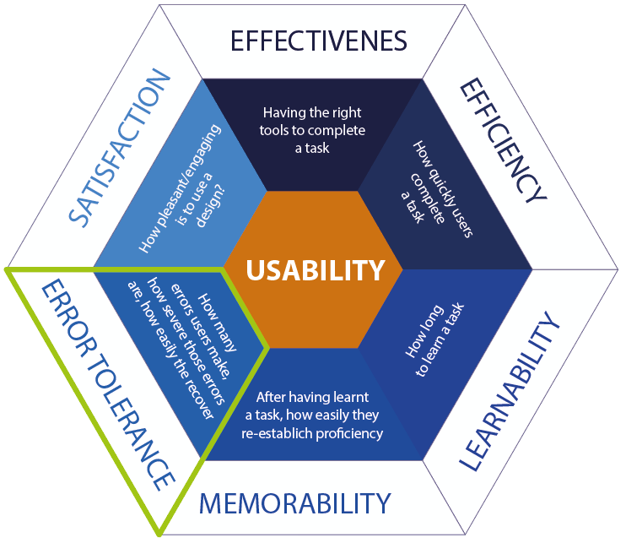
UX - Error tolerance/safety [2]
safe to use (safety)
  protect the user from dangerous conditions and undesirable situations
    hazardous conditions
    e.g. an x-ray machine needs to be operated remotely
    help any kind of user in any kind of situation avoid the danger of carrying out unwanted actions accidentally
  Making systems safer involves:
    prevent the user from making serious errors by reducing the risk of wrong key/buttons being mistakenly activated
    Provide the user with various means of recovery. Safe interactive systems should engender confidence and allow the user the opportunity to explore the interface to try out new operations

Slide 39
UX - Error tolerance/safety
safe to use (safety) (continuous)
Example – which menu is safe and which unsafe and why?
Warning…
You haven’t read all those messages; trash them anyway?
Trash & Don’t Warn
Trash
Don’t trash
  Q: Does the system prevent users from making serious errors and, if they do make an error, does it permit them to recover easily?

Slide 40

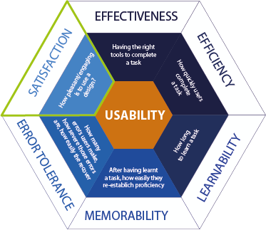

UX – Satisfaction/Engagement
If users find it appropriate for its industry/topic and pleasant to use.
It deals with:
  How is it measured?
  features
  Time
  Rating
  Opinions
  what makes users like a product
  how long they can keep using a product (game)
  task level satisfaction
  post task satisfaction

Slide 41
An extended list of experience goals
Satisfying
Enjoyable
Fun
Entertaining
Helpful
Motivating
Aesthetically pleasing
Supportive of creativity
Rewarding
Emotionally fulfilling
Notes:
What the interaction feels like to the users.
This involves explicating the nature of the user experience in subjective terms. E.g. a software package for children to create their own music may be designed with the primary objectives of being fun and entertaining. Hence, user experience goals differ from the more objective usability goals in that they are concerned with how users experience the interactive product from their perspective.

Slide 42
Enjoyable
Some aspects that have been describe as contributing to pleasure include:
  attention
  pace
  play
  interactivity
  conscious and unconscious control
  engagement
  style of narrative
Easy to use is not always more enjoyable and fun
Notes:
Easy to use is not always more enjoyable and fun, e.g. interacting in VR with a virtual character and trying to hit a nail with a plastic hammer, it would be much easier and effective using a command line, but not necessarily more enjoyable and fun.

Slide 43
A brief history of usability testing

Slide 44
Scope of usability testing in the 80s
Early usability testing (in the 1980s, mostly for software interfaces) had its origins in two traditions that called for large numbers (and therefore much money).
  it was modelled on academic psychology studies where having enough people to reach statistical validity was a critical factor
  the goal was usually “validation” – testing once at the end just before release with the goal of showing that all was well

Slide 45
A brief history of usability testing
We quickly learned that the previously model was not right and the focus of usability testing then shifted. Key words for usability testing now are early, often and iterative

Slide 46
Scope of usability testing in the 90s
The new model
  small-scale and “discount”
    how many participants you need in each test cycle is still a matter of controversy
    Jakob Nielsen introduced the notion of “discount usability engineering” in the early 1990s.
    According to Nielsen & Landauer (1993) The best results come from testing no more than 5 users and running as many small tests as you can afford
    Nielsen, Jakob & Landauer, Thomas K.: "A mathematical model of the finding of usability problems," Proceedings of ACM INTERCHI'93 Conference (Amsterdam, The Netherlands, 24-29 April 1993), pp. 206-213.
    when you have a series of usability tests, as your prototype moves through design and development, you can do each test cycle with only a few people
    Lindgaard & Chattratichart suggest that what matters most isn’t how many people you involve in your usability test but how many different tasks they try
    Gitte, Lindgaard & Jarinee, Chattratichart (2007) Usability testing: what have we overlooked?, CHI '07 Proceedings of the SIGCHI conference on Human factors in computing systems , ACM New York, NY, USA.

Slide 47
A brief history of usability testing
The new model (continuous)
  looking for and diagnosing problems
    the greatest benefit of usability testing is finding out what is not working well, it helps to find and understand the problems people are likely to have so that you can fix those problems and thus keep hundreds (thousands? millions?) of other people from having those same problems
  “quick and dirty” or “quick and clean” formative evaluation is a well-established social science technique
    a prototype is created and tried out with people, fixed, then tried out again, and so on – while it’s still being developed

Slide 48
Recap
The key factors to consider when designing a digital product
Clarification of terminology used interchangeably
Defined user experience design
Defined user interface design
Defined usability testing
The metrics of usability testing
History of usability testing
Next week - types of usability testing & usability testing methods

Slide 49
Test your understanding
What are the key factors to consider when designing a digital product?
What is UX design?
What is UI design?
What is usability?
What is usability testing?
What are the main usability testing goals/metrics?
What values do we collect for usability testing?
What data biometric test provide and how those evaluate usability metrics?
Can you think of some extended usability testing goals? What might be the issue with those?
What drove usability testing and the 80s?
What are the current trends in usability testing?

Slide 50
Reading
Carol M. Barnum (2020) Usability testing essentials, Ready, Set... Test!, Morgan Kaufmann.
  Chapter 1, Establishing the essentials
  Chapter 2 Testing here, there, everywhere
Rubin, J. & Chisnell, D. (2008) Handbook of usability testing: how to plan, design, and conduct effective tests, second edition. 2nd ed. Indianapolis, Ind: Wiley.
  Chapter 1. What Makes Something Usable?
  Chapter 2. What Is Usability Testing?
Online Resources
  Definition of User Experience
    https://www.nngroup.com/articles/definition-user-experience/
  Usability 101: Introduction to Usability
    https://www.nngroup.com/articles/usability-101-introduction-to-usability/
  Usability Testing 101
    https://www.nngroup.com/articles/usability-testing-101/
  Measuring Usability with biometrics
    Phukan, A. (2009). Measuring Usability via Biometrics. In: Ozok, A.A., Zaphiris, P. (eds) Online Communities and Social Computing. OCSC 2009. Lecture Notes in Computer Science, vol 5621. Springer, Berlin, Heidelberg. https://doi.org/10.1007/978-3-642-02774-1_11

